Slide 1
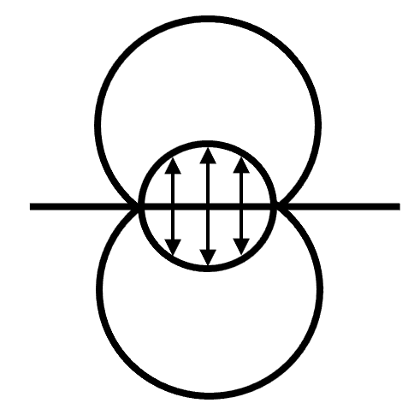
13rd International Conference on Contact Mechanics and Wear of Rail/Wheel Systems (CM2025), Tokyo, Japan, September 22-26, 2025
Title OF Poster
Author, Author, Author
Affiliations
Feel free to use your own format (text boxes, font size, font type, number of figures, logos, etc).
・This slide must be submitted as a PDF file. Therefore, it is not possible to include videos in the slide for the shotgun session.

