Slide 1
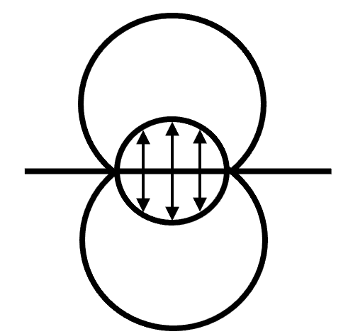
13rd International Conference on Contact Mechanics and Wear of Rail/Wheel Systems
(CM2025), Tokyo, Japan, September 22-26, 2025
Title OF Poster
Author, Author, Author
Affiliations
HEADLINE
Please, use poster size A0, 118.9x84.1 cm.
Please keep the headings of the conference.
Feel free to use your own format (text boxes, font size, font type, number of figures, logos, etc).
CM2025 organizer can print your poster free of charge if your ready-to-print poster is sent to the organizer no later than 22 August, 2025.

